Slide 1
Experiment-4

Slide 2
Installation of Docker Desktop

Slide 3


Prepared By
Bhuvnesh Sanathra
Semester-7

Slide 4
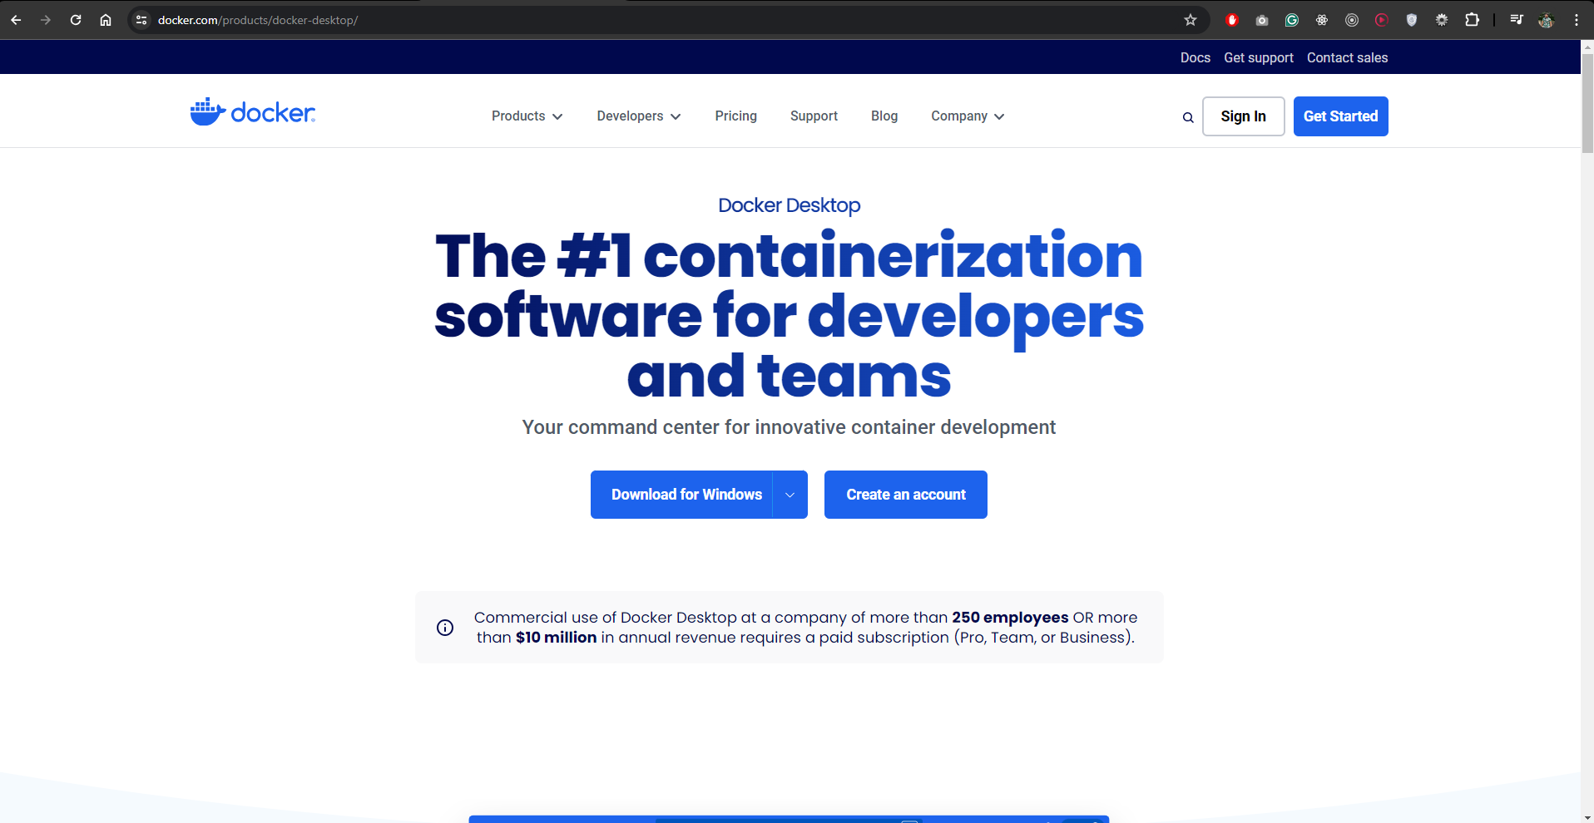
Docker Desktop Installation
For downloading the Docker Desktop visit https://www.docker.com/products/docker-desktop/
Click on Download For Windows

Slide 5
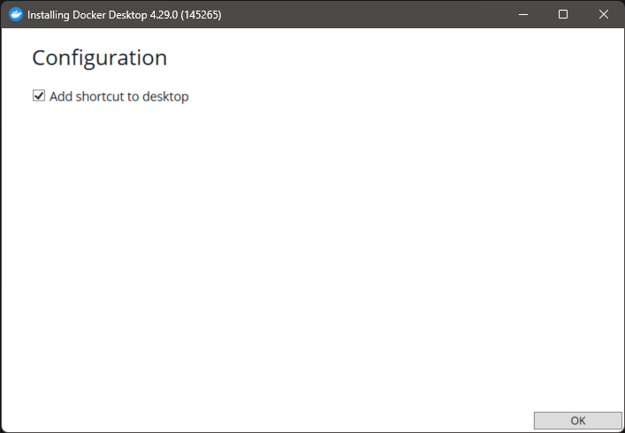
Docker Desktop Installation
Open the setup once installation is done
Click OK

Slide 6
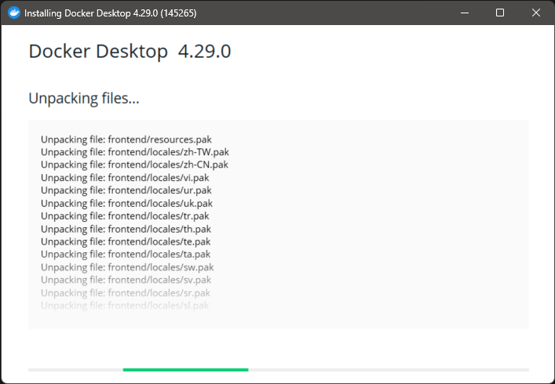
Docker Desktop Installation
Installation Started

Slide 7
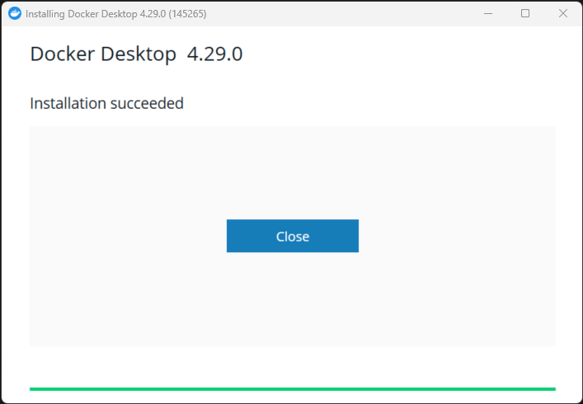
Docker Desktop Installation
Installation Done!

Slide 8
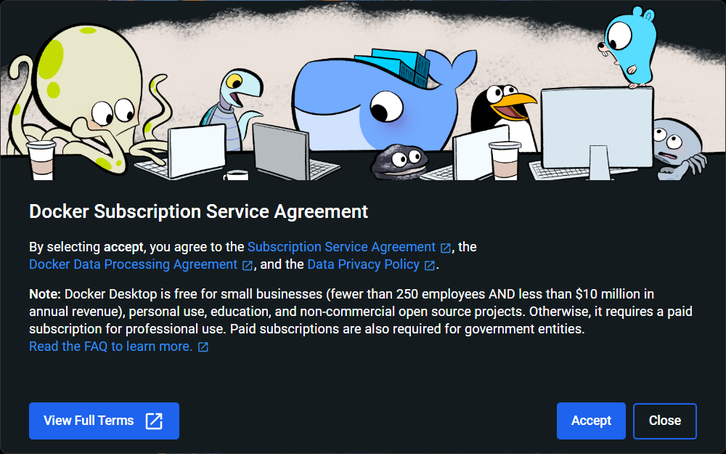
Docker Desktop Installation
Open the Docker Desktop & Accept it
Accept

Slide 9
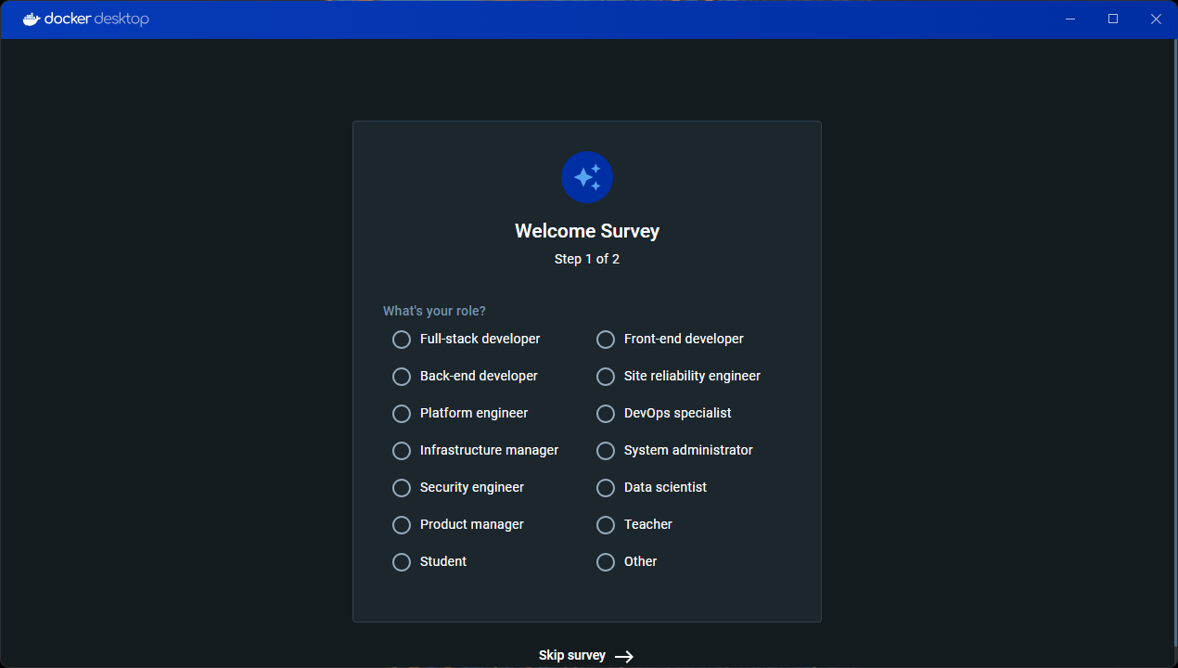
Docker Desktop Installation
If you want to perform Survey select role else Skip Survey

Slide 10
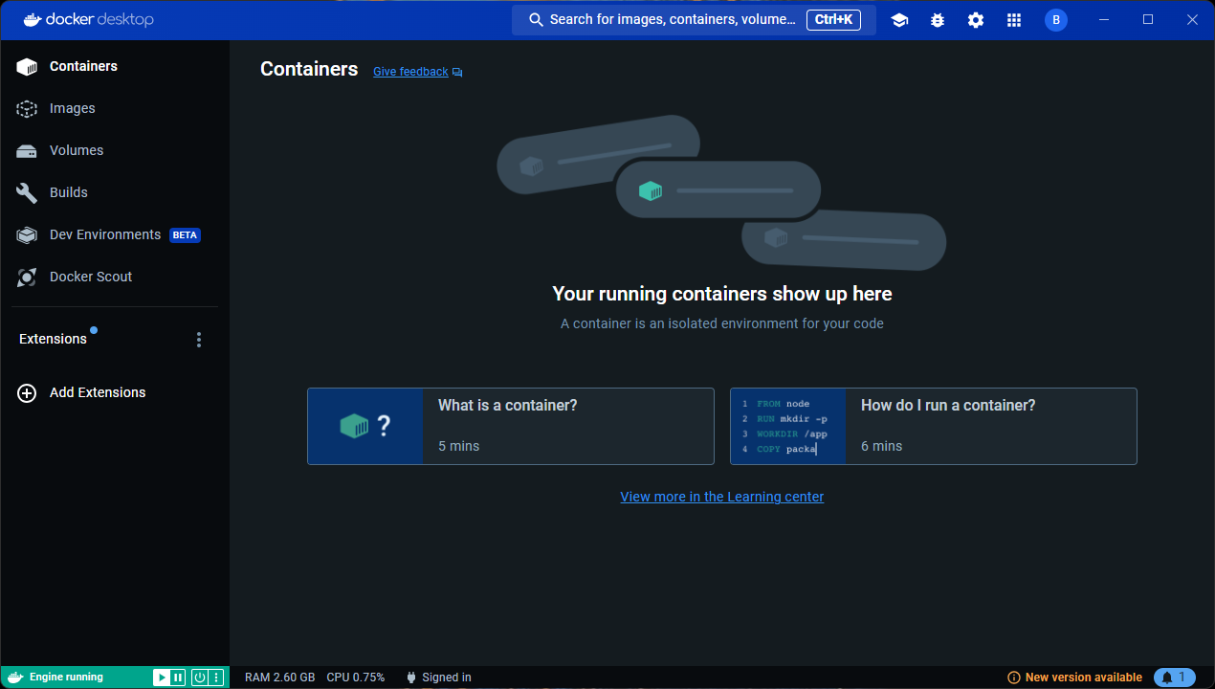
Docker Desktop Installation
Docker Desktop is installed successfully.

Slide 11
Thank You

